Slide 1

Year 4 | Week 8 | Day 1

Slide 2


Year 4 | Week 8 | Day 2

Slide 3
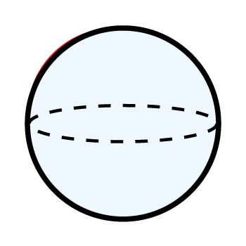
Year 4 | Week 8 | Day 3

Slide 4
Year 4 | Week 8 | Day 4

Slide 5


Year 4 | Week 8 | Day 5

Slide 6

Year 4 | Week 9 | Day 1

Slide 7
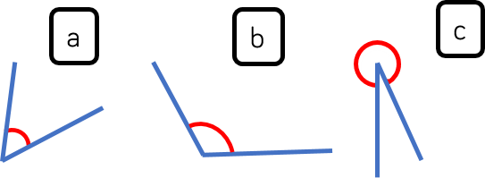
Year 4 | Week 9 | Day 2

Slide 8
Year 4 | Week 9 | Day 3

Slide 9
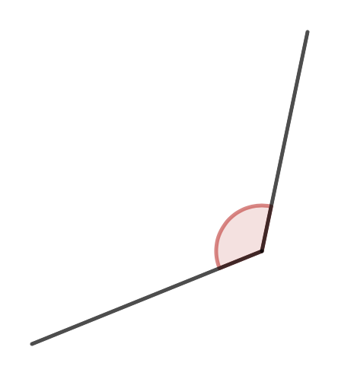
Year 4 | Week 9 | Day 4

Slide 10

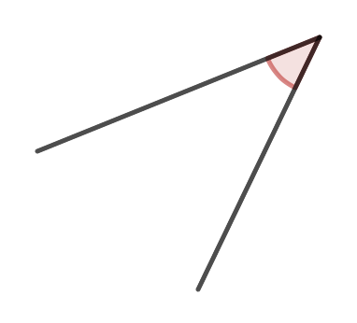
Year 4 | Week 9 | Day 5

Slide 11
Year 4 | Week 10 | Day 1

Slide 12
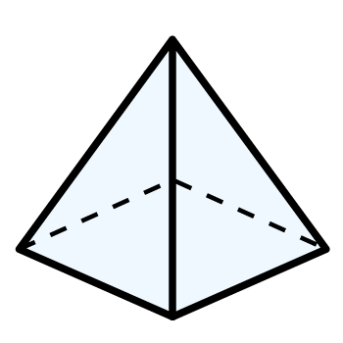
Year 4 | Week 10 | Day 2

Slide 13
Year 4 | Week 10 | Day 3

Slide 14
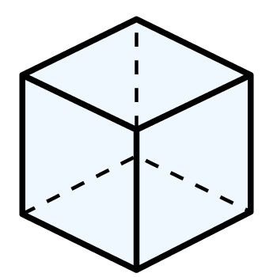
Year 4 | Week 10 | Day 4

Slide 15
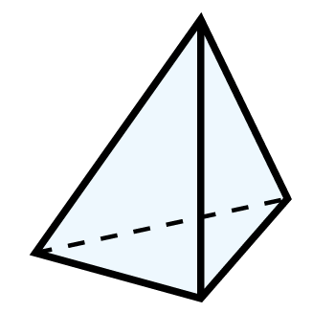
Year 4 | Week 10 | Day 5

